Slide 1
Student Dropout Prediction
Machine Learning-Powered Early Intervention
Presented by: Alaa Wafiek
Instructor : Donia Ghars Aldin

Slide 2

Saving Students Before They Drop Out
Every year, thousands of students silently drop out. What if we could predict who’s next and stop it?

Slide 3
Why should we care?
Before (Manual) | After (With ML)
Teachers guess risk | System flags risk
One-size-fits-all | Personalized attention
Reactive approach | Preventive intervention

Slide 4
Table of contents
01
02
04
06
Project Overview
EDA, Data cleaning and preprocessing
03
Model Building and Evaluation
Key Findings & SQL Insights
05
Power BI Dashboards
Recommendations & Deployment

Slide 5

01
Project Overview
Predict student dropouts using ML

Slide 6
Introduction
Pipeline Includes:
Data collection & cleaning
Feature engineering
Model training (Logistic & RF)
SQL queries for insights
Dashboards for stakeholders

Slide 7
02
EDA, Data cleaning and preprocessing

Slide 8

—Understanding the Dataset
649 Students | Target: Dropped_Out Features:
Demographics: Gender, Parents’ Education
Academics: GPA, Failures, Study Time
Behavior: Absences, Internet, Extra Activities

Slide 9
Data Preprocessing
Data Exploration
info(): Checks data types and non-null values.
isnull().sum(): Helps find missing values.
describe(): Summary of numerical data (mean, std, etc.).
value_counts(): Check balance of dropout vs no-dropout.

Slide 10
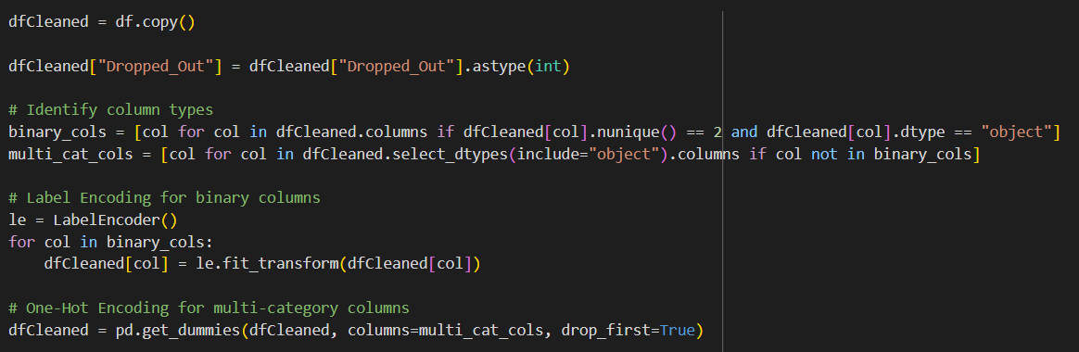
Data Preprocessing
One-Hot Encoding (multi-class)
Binary encoding (Yes/No)
Outliers: Absences capped at 95th percentile
Train/Test: Stratified Split 80/20

Slide 11
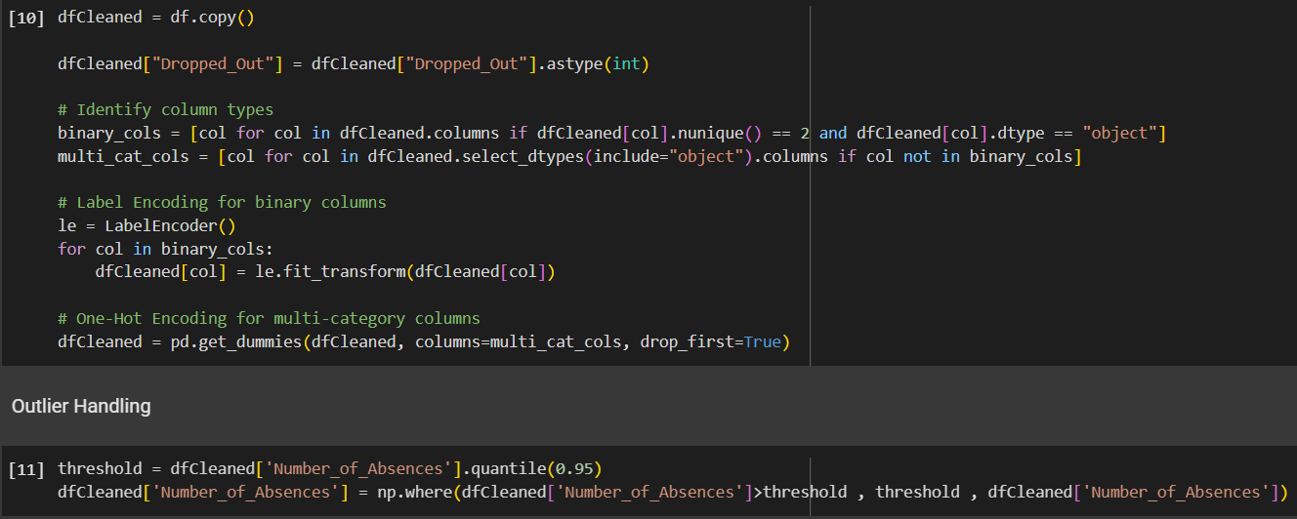
Data Preprocessing
Encoding and outliers Handling

Slide 12
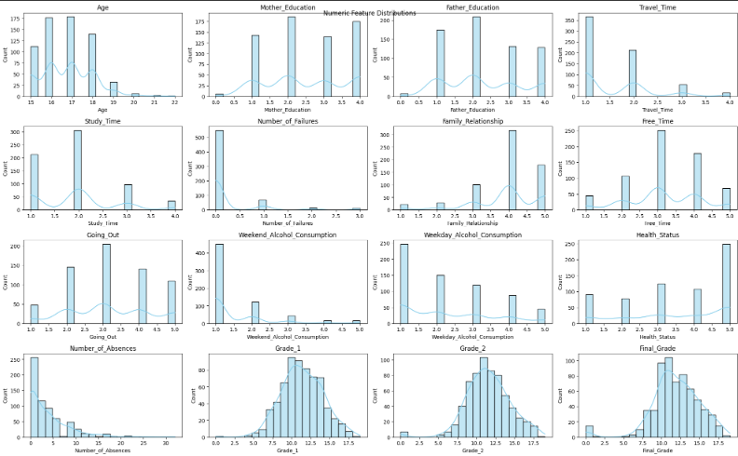

Slide 13
03
Model Building and Evaluation

Slide 14
Model Building & Results
Model | Accuracy | Notes
Logistic | 97% | Interpretable
Random Forest | 100% | Overfitting

Slide 15
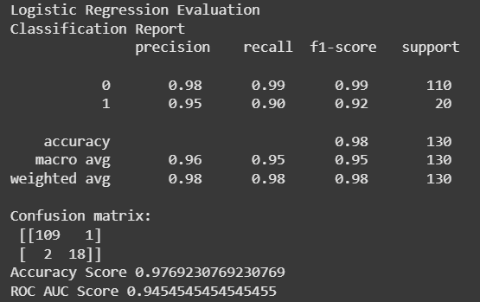
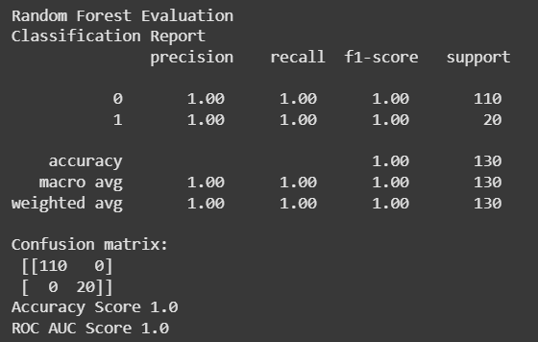
Model Building & Results

Slide 16
Top Features
Grade 2
1-
2-
3-
Final Grade
Grade 1
4-
5-
Age
Mother Education

Slide 17

04
Key Findings & SQL Insights

Slide 18
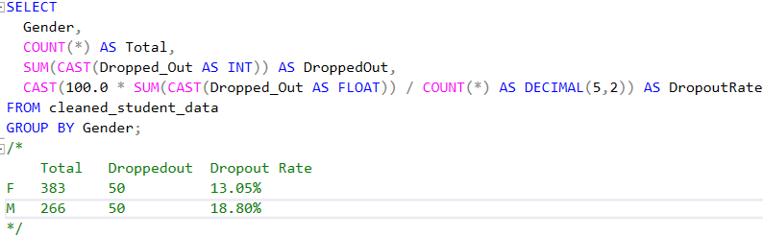
SQL Insights
Based on SQL Analysis:
Dropout Rate: 15.41%
Males: 18.8% | Females: 13.05%
<10 GPA = 100% dropout

Slide 19
05
Power BI Dashboards

Slide 20
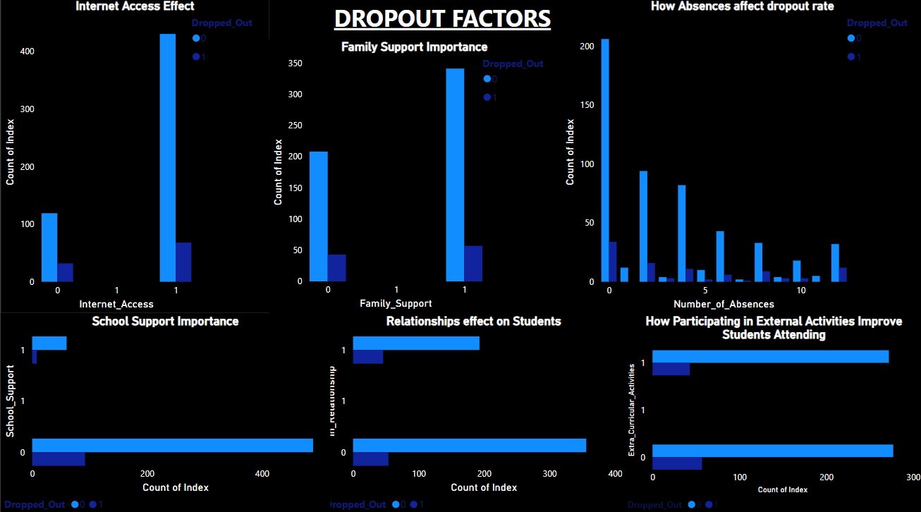

Slide 21
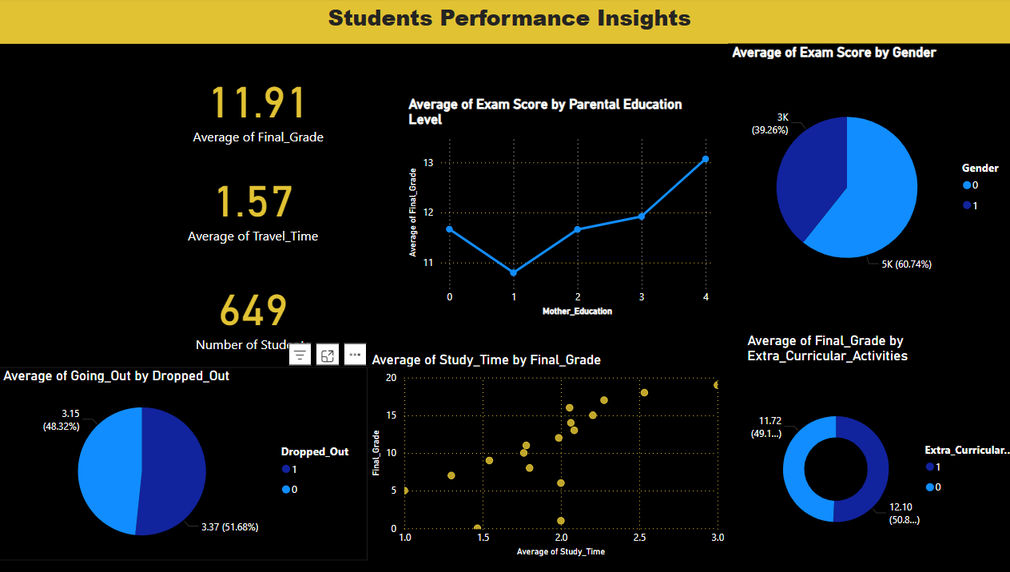

Slide 22
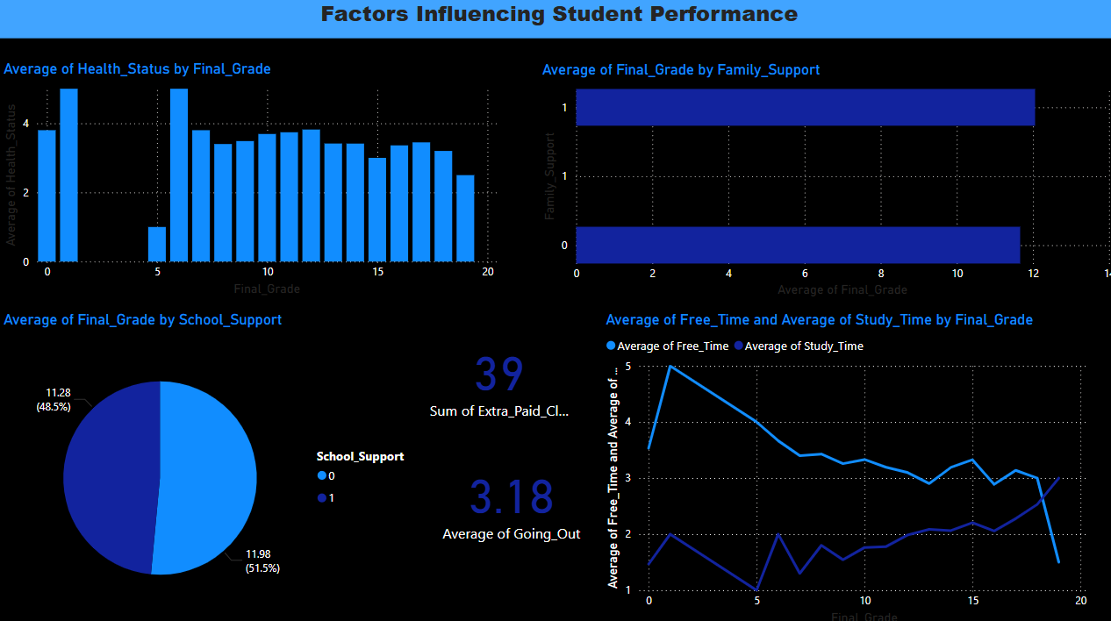

Slide 23
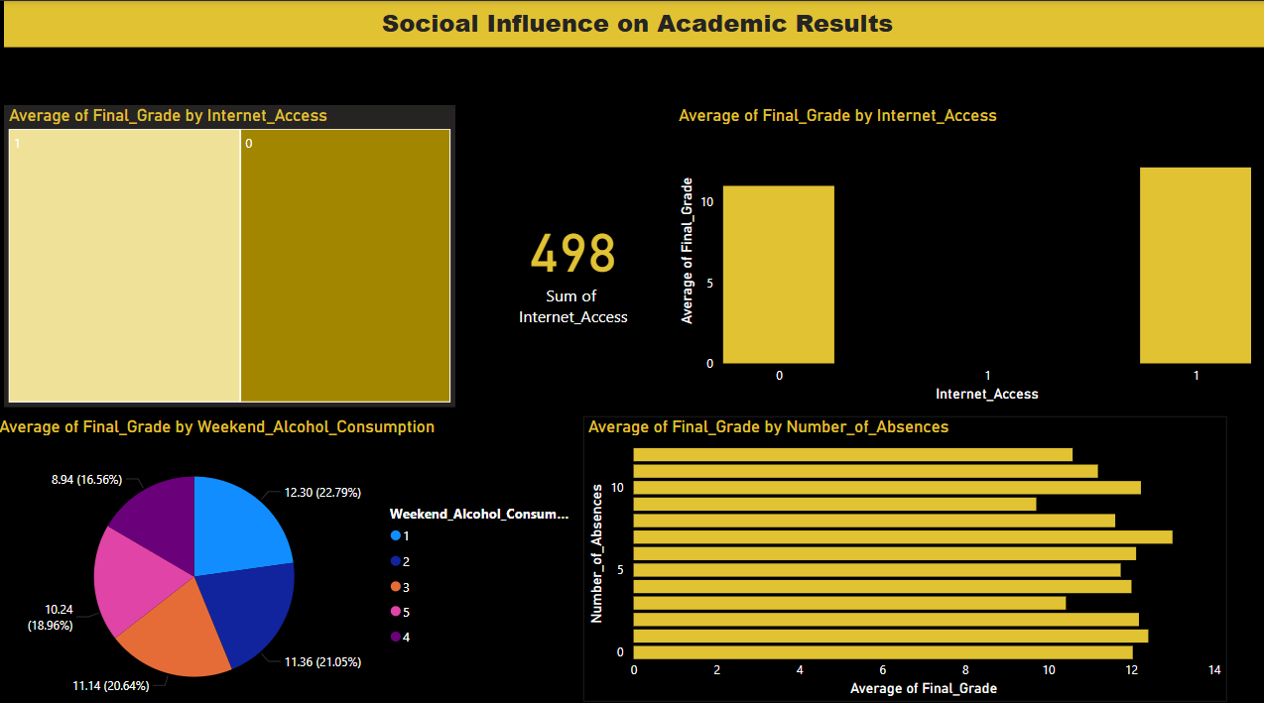

Slide 24
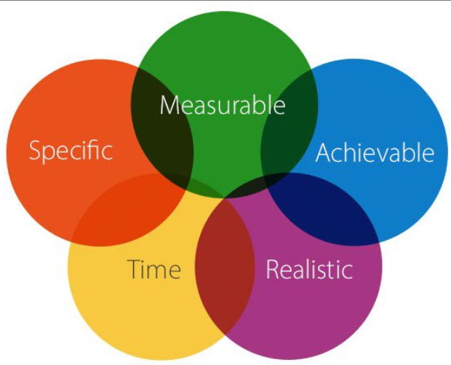
SMART Goals
Specific | Measurable | Achievable | Relevant | Time-Bound
Target at-risk students | 5% drop in 6 months | Yes | Supports school goals | 6 months

Slide 25
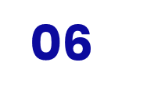
Final Recommendations

Slide 26
Use of Model
Objective:
Detect high-risk students through predictive analytics to reduce dropout rates proactively
. Use model alerts to flag students . Engage low-performing students early . Involve parents with low education . Encourage extracurricular activities . Track and enforce attendance

Slide 27
Thanks!
Do you have any questions?
Presented by: Alaa Wafiek
Instructor : Donia Ghars Aldin

